Slide 1



AtilQ Hardwares
CONSUMER GOODS
AD-HOC INSIGHTS
Domain : Consumer Goods | Function : Executive Management
Prasad MVV

Slide 2
CONTENT
Objective
ERD Diagram
Queries, Insights
Suggestions

Slide 3
OBJECTIVES
AtilQ Hardwares is one of the leading computer hardware producers in India and well expanded in other countries too.
However, the management noticed that they do not get enough insights to make quick and smart data-informed decisions. They want to expand their data analytics team by adding several junior data analysts.
Tony Sharma, their data analytics director wanted to hire someone who is good at both tech and soft skills. Hence, he decided to conduct a SQL challenge which will help him understand both the skills.

Slide 4
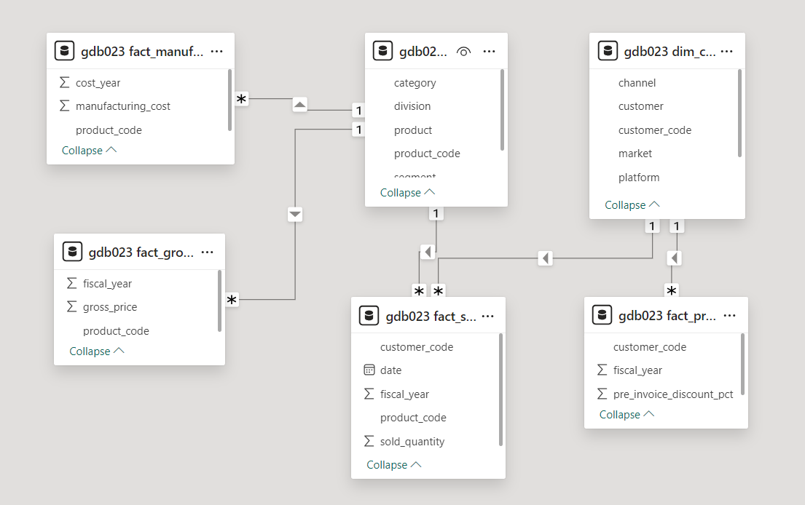
Entity Relationship Diagram (ERD)

Slide 5
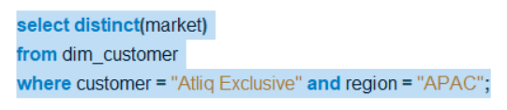
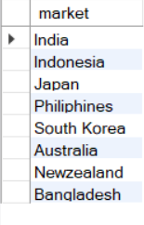
REQUESTS
1. Provide the list of markets in which customer "AtliQ Exclusive" operates its business in the APAC region.
Insights
The customer AtilQ Exclusive operates its business in APAC region
across 8 different markets.

Slide 6
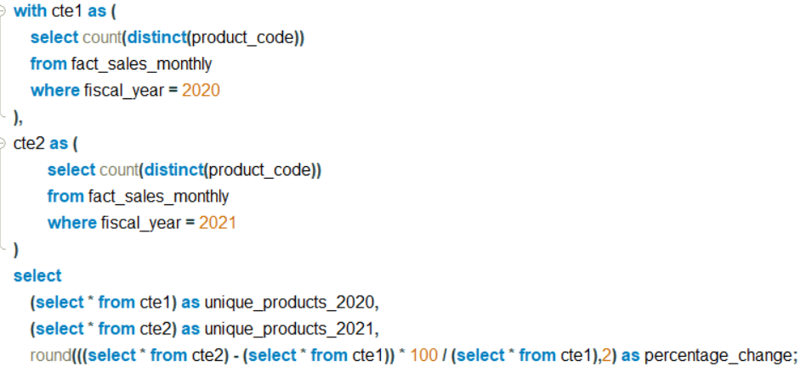

REQUESTS
2. What is the percentage of unique product increase in 2021 vs. 2020? The final output contains these fields,
unique_products_2020
unique_products_2021
percentage_chg
Insights
In fiscal year 2020, AtliQ Hardware's had 245 unique products which are increased to 334 in 2021,
reflecting growth of 36.33%

Slide 7
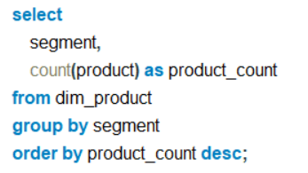
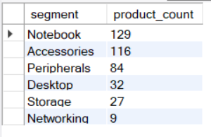
REQUESTS
3. Provide a report with all the unique product counts for each segment and sort them in descending order of product counts. The final output contains 2 fields, segment product_count
Insights
At AtliQ Hardware, they offer a wide range of notebooks, accessories and peripherals.
But they should consider expanding their offerings in desktops, networking and storage categories
Along with focusing on increasing the sales of portable items.

Slide 8
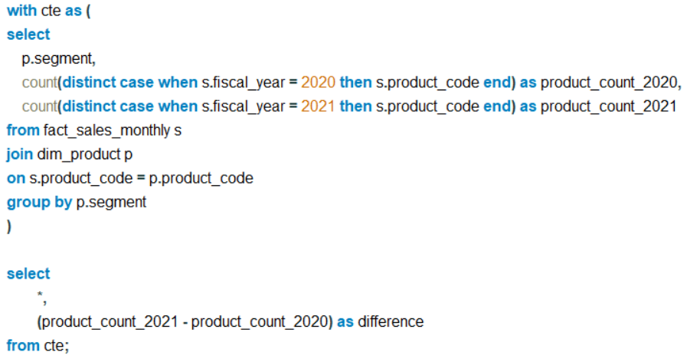
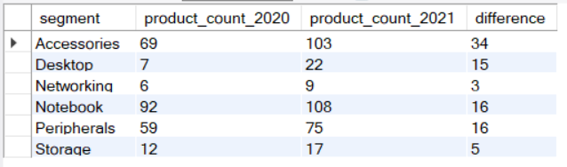
REQUESTS
4. Which segment had the most increase in unique products in 2021 vs 2020? The final output contains these fields, segment product_count_2020 product_count_2021 difference
Insights
AtliQ experienced a net worthy 34 product increase in its Accessories segment from 2020 to 2021, reflecting
substantial expansion within just one year.

Slide 9
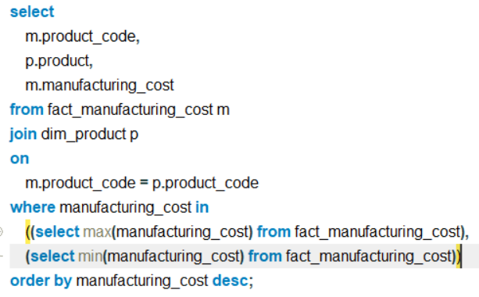
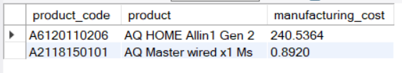
REQUEST
5. Get the products that have the highest and lowest manufacturing costs. The final output should contain these fields, product_code product manufacturing_cost
Insight
At AtliQ Hardwares, AQ Home Allin 1 Gen2 has highest manufacturing cost with 240.5364 where as
AQ Master wired x1 Ms has lowest manufacturing cost with 0.8920

Slide 10
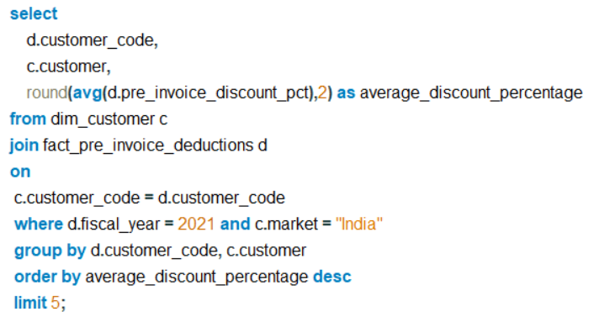
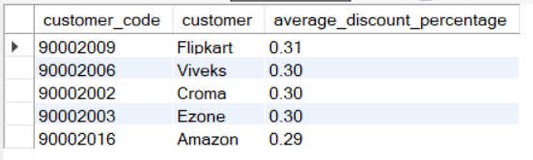
REQUEST
6. Generate a report which contains the top 5 customers who received an average high pre_invoice_discount_pct for the fiscal year 2021 and in the Indian market. The final output contains these fields, customer_code customer average_discount_percentage.
Insight
AtliQ Hardware offers varying discount percentage to its customers, with Flipkart having the highest average
discount percentage of 30.83%, closely followed by Vivek's, Croma, Ezone, Amazon.

Slide 11
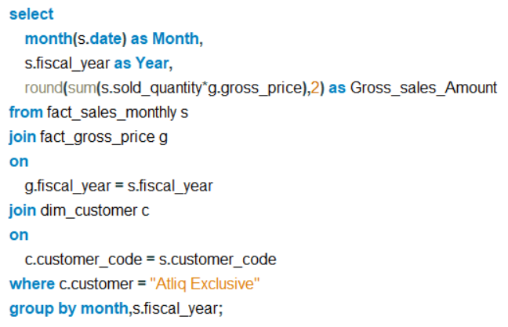
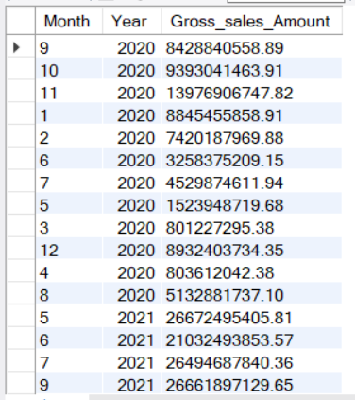
REQUEST
7. Get the complete report of the Gross sales amount for the customer “AtliQ Exclusive” for each month . This analysis helps to get an idea of low and high-performing months and take strategic decisions. The final report contains these columns: Month, Year, Gross sales Amount
Insight
AtliQ Exclusive saw lowest sales during March FY 2020 and got highest
sales during November FY 2021.

Slide 12
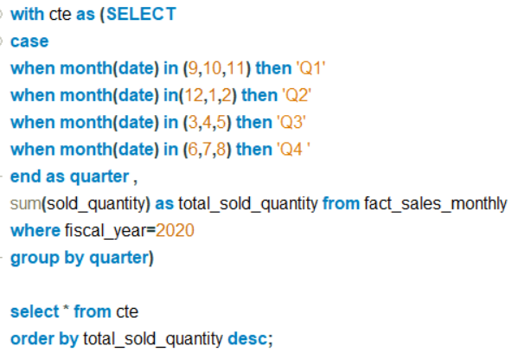
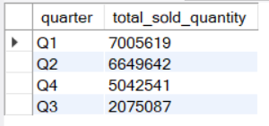
REQUEST
8. In which quarter of 2020, got the maximum total_sold_quantity? The final output contains these fields sorted by the total_sold_quantity, Quarter total_sold_quantity
Insight
Q1 got the maximum total_sold_quantity which is 7M.
The emergence led to a significant decline in sales, dropping
from 6.6 million units in Q2 to 2 million units in Q3.
However, the increasing demand for remote work and online
activities drove sales to rebound, reaching 5M units n Q4.

Slide 13
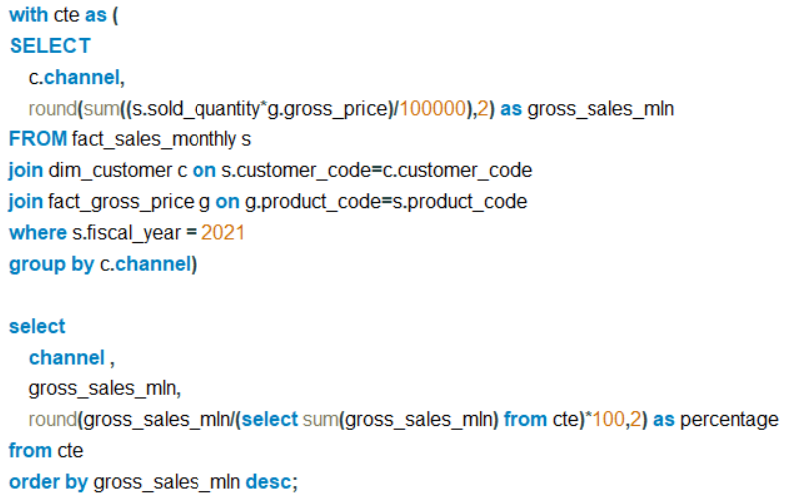
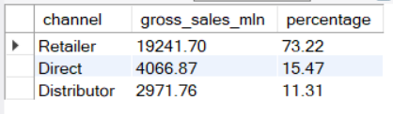
REQUEST
9. Which channel helped to bring more gross sales in the fiscal year 2021 and the percentage of contribution? The final output contains these fields : channel, gross_sales_mln, percentage
Insight
In 2021, sales from retailers accounted for a large portion, approximately 73% of total sales. Meanwhile, sales
Through direct channels and distributors were about similar.

Slide 14
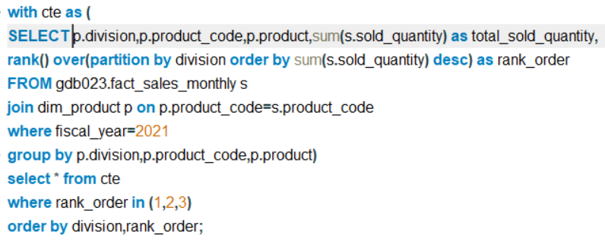
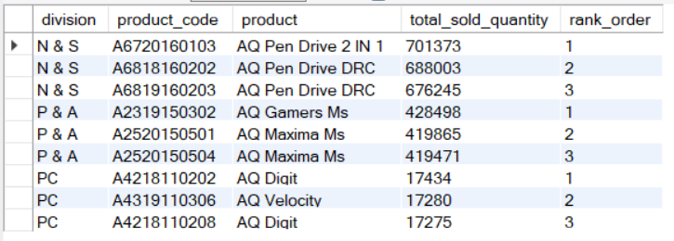
REQUEST
10. Get the Top 3 products in each division that have a high total_sold_quantity in the fiscal_year 2021? The final output contains these fields : division, product_code, product, total_sold_quantity, rank_order
Insight
In 2021, the top 3 selling products were
Pen Drives
Mouses
Personal Laptops

Slide 15
AtilQ Hardwares
Thank You !
Prasad MVV

